Slide 1
Simple Shooter
Part 4
by TommyX

Slide 2
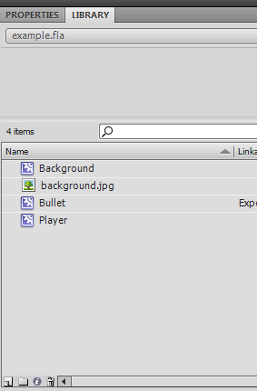
Creating Effects
Special effects are crucial to make a game look more polished, for example muzzle flashes, sparks, explosions.
We will be creating them and spawning them with code. As an example, we will create a simple explosion effect that spawns when the bullet hits the enemy.
Lets start by creating a new symbol, just like creating the bullet.
Click here to create a new symbol.

Slide 3
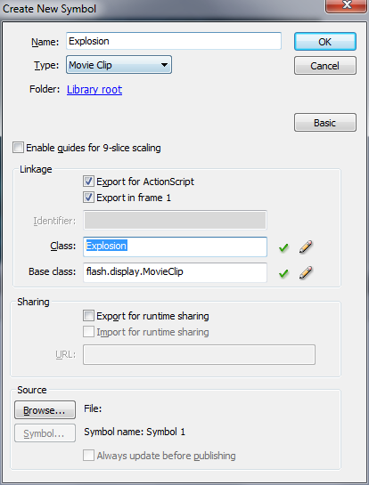
Creating Effects
Assign a library name and a class name.
Make sure to select type Movie Clip.

Slide 4
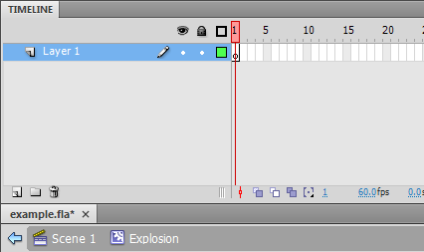
Timeline and Animation
The Timeline system in Flash is a powerful tool for creating animations.
Notice that each symbol has its own timeline here with completely different set of layer. That means each symbol can play its own animation independently, which is exactly what we need to create our explosion effect.

Slide 5

Timeline and Animation
Blank Key Frame
Blank Frame
Filled Key Frame
Filled Frame
Each timeline contains multiple frames that will be played from left to right.
There are 2 types of frames: The key frames and the (normal) frames.
Key frames: frames that contain an entirely new picture data.
Normal frames: frames doesn’t contain picture data, and will by default display picture from the closest previous key frame.

Slide 6
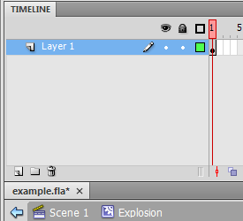
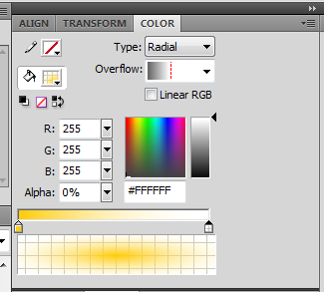
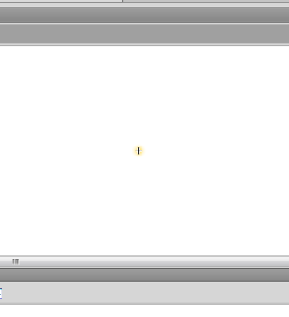
Creating Explosion
Lets start by drawing the first frame of the explosion, which is the beginning of the explosion: a very small circle.

Slide 7
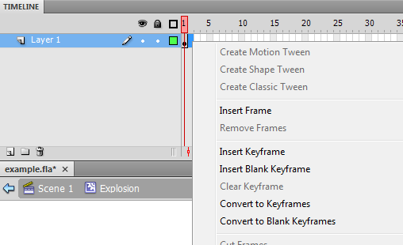
Creating Explosion
Lets draw the second frame of the animation.
To create a new key frame, right click on an empty frame on the timeline and select “Insert Keyframe”. This will create a keyframe that contains the same picture data as the closest previous frame. If you want to draw an entirely new picture, select “Insert blank Keyframe”.

Slide 8
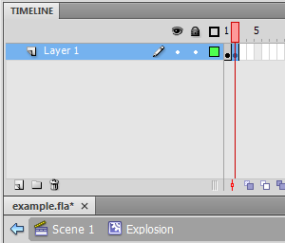

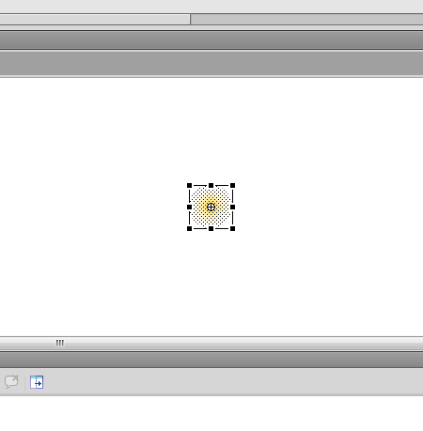
Creating Explosion
Now select the circle, use the free transform tool to enlarge it a little bit.

Slide 9
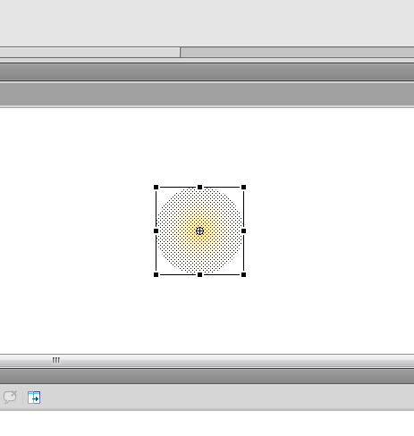
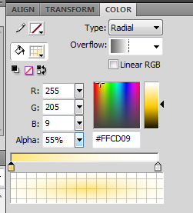
Creating Explosion
Lets draw the third frame of the animation.
Right click and select Insert Keyframe.
Then stretch the circle to be even larger. Modify the color as well to make it a little bit transparent.

Slide 10
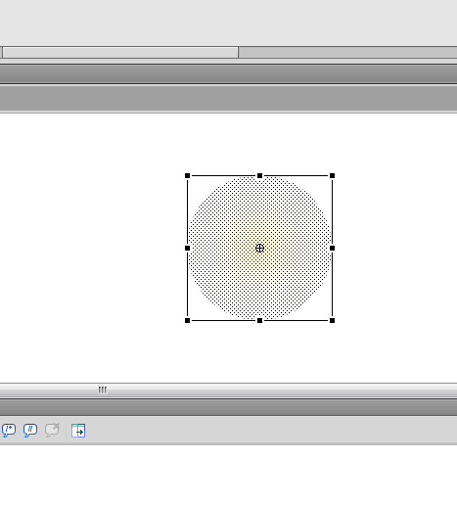
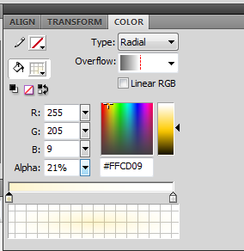
Creating Explosion
Now draw the fourth and final frame of the animation.
Stretch the circle to be even larger. Modify the color so that it looks very transparent.

Slide 11
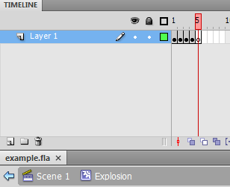
Creating Explosion
Lets insert a blank keyframe for the fifth frame.
In this frame, we will write a little bit of script to remove this object, or else by default the animation will loop forever.
Click on the frame and edit the script in the Action panel.
Write the code below to stop the animation, and remove it from the display list. The keyword “this” refers to the current object.
stop()
this.parent.removeChild(this)

Slide 12
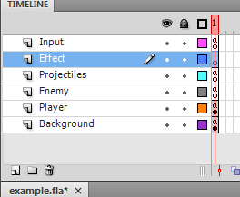
Spawning Explosion
Now we have our object ready, lets spawn it with code.
Lets create a new layer to manage our effects.
Then, click on the frame of that layer to change the code.
Click here to create a new layer.
Double click to change layer name. Drag to arrange them.

Slide 13
Organizing Containers
At this point, we are having more and more objects spawned with code. Adding all of them to the root display container would be unwise. Therefore, we should make separate containers that are added to the root display container, and the have our bullet/effects etc added to those containers.
In the Effect layer for example, write the following code before you write the spawning function:
Sprite is the default type for an empty display object container.
You should do this for all other layers that spawn objects, and inside the spawn function, add the objects to the desired containers.
var effectContainer:Sprite = new Sprite()
addChild(effectContainer)

Slide 14
Spawning Explosion
Lets start writing the spawnExplosion function. We should pass in the X and Y position for the explosion, and then create it using its class name and constructor, initialize its position to the position we pass in, then add it to the effectContainer we just created.
var effectContainer:Sprite = new Sprite()
addChild(effectContainer)
function spawnExplosion(posX:Number, posY:Number){
var explosion:Explosion = new Explosion()
explosion.x = posX
explosion.y = posY
effectContainer.addChild(explosion)
}
That’s it for now. The object will remove itself so we don’t have to worry about it here.

Slide 15
Spawning Explosion
Now go to the Projectile layer, and add the spawnExplosion function call when the bullet hit the enemy.
…blah blah
for (var i = 0; i < enemyList.length; i++){
if (enemyList[i].hitTestPoint(bullet.x, bullet.y)){
spawnExplosion(bullet.x, bullet.y)
enemyList[i].health -= damage
bullet.parent.removeChild(bullet)
bullet.removeEventListener(Event.ENTER_FRAME, loop)
}
}
if (bullet.x > stage.stageWidth){
…blah blah

Slide 16
Additional Information
More info on Animation:
http://www.adobe.com/inspire-archive/december2008/articles/article4/index.html?trackingid=EFBLB
http://www.baycongroup.com/flashCS4/09_flashCS4.html#Frames

